Slide 1

AI Lab WEEK 6
Dr. Mubashir Ahmad

Slide 2
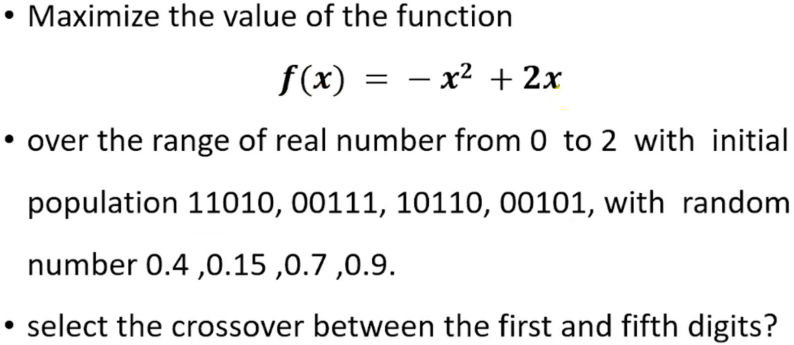
Genetic Algorithm Implementation

Slide 3
Genetic Algorithm Implementation

Slide 4
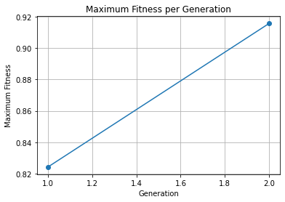
Genetic Algorithm Implementation
# Plot the maximum fitness per generation
plt.plot(range(1, NUM_ITERATIONS + 1), max_fitness_per_generation, marker='o')
plt.xlabel('Generation')
plt.ylabel('Maximum Fitness')
plt.title('Maximum Fitness per Generation')
plt.grid(True)
plt.show()

Slide 5
Tasks
#1: Write a code for encoding a binary number
#2: Decoding the number in range of 0 and 2
#3: Implement a fitness function
#4: Implement a Genetic algorithm steps.
#5: Plot the maximum number in generations.
#6: Integrate the code for maximization problem.

